Slide 1
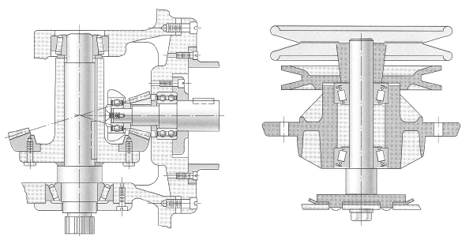
Shafts, Axles, and Couplings
ME 313: Mechanical Design
Week 11

Slide 2
Topics to Cover
Shafts and Axles
Overview
Strength considerations
Speed considerations
Couplings
Overview
Pins and keys
Tapered Couplings

Slide 3
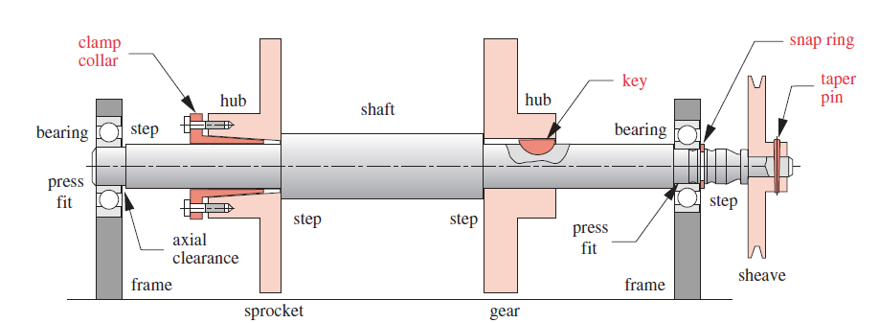
Shafts and Axles
Shafts
transfer of torque or rotation from source to intended component(s)
Axle
nonrotational component used to support rotational parts

Slide 4
Typical Shaft Designs
To transmit power from driving device (motor or engine) to machine, gears, pulleys, flywheels, clutches, or sprockets are mounted on shaft
Torque is transmitted to shaft by press fit, keys, or pins
Shaft rotates usually on rolling contact bearing or journal bearing

Slide 5
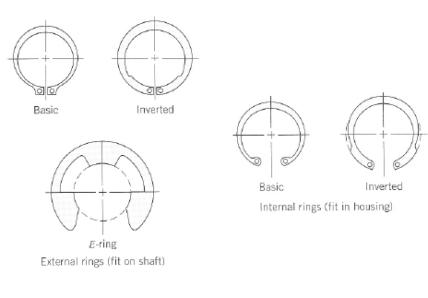
Typical Shaft Designs (Cont)
Retaining rings
take axial load and retain shaft positions

Slide 6
Strength Considerations
Shaft and axle are subjected to these loads
bending
torsion
shear
We have to make sure shafts can take these combined loads to operate

Slide 7
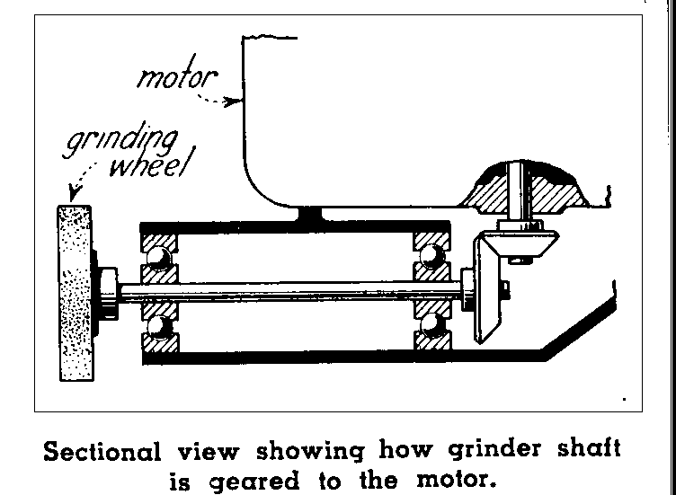
Bending Loads in Shafts
Transverse load away from fulcrum point causes bending
radial load from gear
belt tension from pulley
Resulting in bending stress

Slide 8
Axial Loads on Shaft
Compressive/tensile load from axial load
axial load from bevel or helical gear

Slide 9
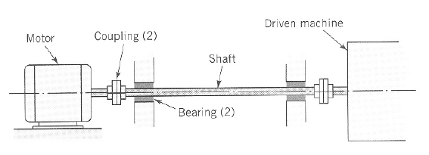
Torsional Loads in Shaft
Shear stress from torsional load

Slide 10
Combined Loading on Shaft
In machine applications, shafts are usually subjected to combined loads
Use stress transformation to analyze stress
principal stresses
maximum shear stress

Slide 11
Speed Consideration
When shaft is spinning, eccentricity causes centrifugal force deflection
for simply supported shaft
for clamped shaft
m is mass per length
l is length of shaft

Slide 12
Example

Slide 13
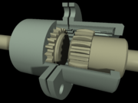
Couplings
Device used to transfer power from one shaft end to another
Can allow misalignment and end movement

Slide 14
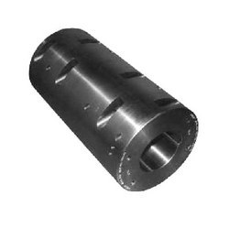
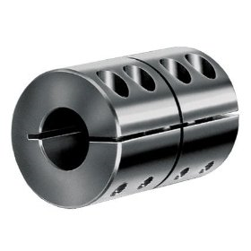
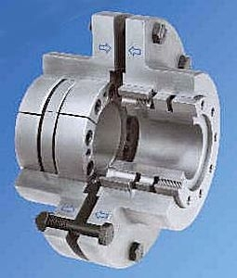
Rigid Couplings
Can transfer large power
no misalignment allowed
no backlash
example: muff couplings, clamp couplings, flange couplings

Slide 15
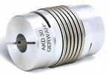
Flexible Couplings
Misalignment (angle and radial) allowed
End movement allowed
Examples: universal coupling, bellow coupling, CV coupling, etc

Slide 16
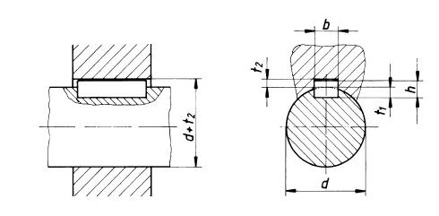
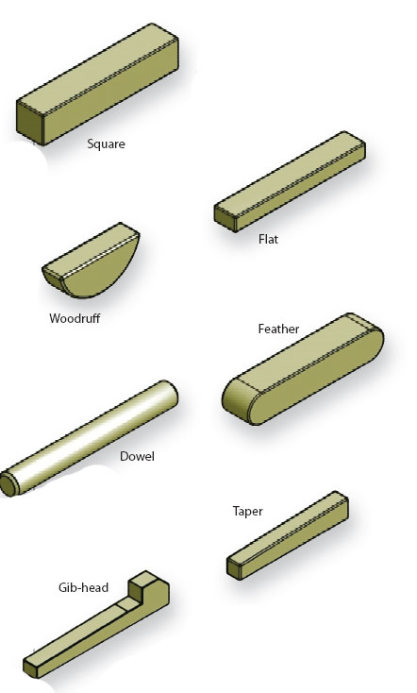
Keys and Keyways
small material inserted in slot to transfer torque between driving mechanism and shaft
shear stress in key is

Slide 17
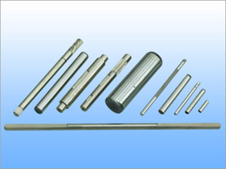
Pins
Used to locate shaft and transfer torque
Shear stress in pin is due to torque T is
R
r

Slide 18
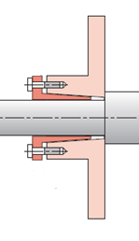
Tapered Coupling
Used to fit a gear or rotating arm to a shaft
by using taper, axial force is translated to radial force, generating friction
α

Slide 19
Tapered Coupling Torque Capacity
F
Assuming uniform pressure
torque capacity depends on friction force
d
P_{a}
d
α

Slide 20
Shaft Assembly General Rules
Shaft should be as short as possible
small overhand
minimize bending stress
increase critical speed
Bearing support should be as farthest apart as possible
provide highest stability

Slide 22
Self-locking Tapered Coupling
In self-locking tapers, friction prevents the taper from slipping out

Slide 23
Self-locking Tapered Coupling: Critical angle
Axial force exerted
When axial force is removed, friction is reversed
tapering angle has to be less than critical for the taper to stay without external load

